Slide 1
MINOR PROJECT
Classification OF CERVIX TYPES using Deep Learning

Slide 2
Nikhil Kansliwal
Prabhat Kumar
Sachin Poonia
Guided BY-
Dr. Manasi Gyanchandani

Slide 3
INTRODUCTION

Slide 4
INTRODUCTION
Cervical Cancer is forth most common type of censer in women worldwide and 7th most common cancer overall.
There were more then 604,000 new cases of cervical censer in 2020 and 341,831 deaths worldwide.
From which 80% deaths occurred in mostly developing and under developed countries.

Slide 5
INTRODUCTION
Test for detection of cervical cancer
PAP Smear test
In pap test we take sample from cervix cells and it is inspected under microscope. This test suffers from high false negative rate.
HPV test:
HPV test is a DNA based test that detects cancer by associating it with a specific HPV type.
Digital cervicography:
This is common in developing countries due to high cost of PAP smear and HPV test.
In this test a photograph of cervix called(Cervi gram) is visually inspected by a human expert.

Slide 6
EXISTING METHODS

Slide 7
EXISTING METHODS
Diagnosis by processing visual information of colposcopic images.
Machine learning algorithms for classification of different stages of cervical cancer.
Classification models that are being used for this purposes are :
SVM,
Random forest.
Cellular based image classification of the cervix cells.

Slide 8
RESEARCH GAPS IDENTIFIED
These shallow feature learning mechanism and hand-craft feature extraction are highly depend on the characteristics of manual selected features.
In cell based classification methods are very costly
In large datasets various Machine Learning Algorithms take high computational power.

Slide 9
DATASET

Slide 10
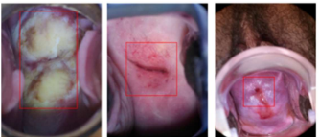
DATASET
It is open source dataset provided by kaggle.
It has 3 types of images based on the Locations of Different transformation zone.
Images are classified as TYPE_1, TYPE_2, TYPE_3.

Slide 11
DATASET
TYPE_1 image:
Has Completely ectocervical components o
Fully visible
Small or large
TYPE_2 image:
Has endocervical components
Fully visible
May have ectocervical component which may be large or small
TYPE_3 image:
Has endocervical component
Is not fully visible
May have ectocervical component which may be small or large

Slide 12
DATA PREPROCESSING AND AUGMENTATION

Slide 13
DATA PREPROCESSING
All images are resized to 512X512.
For image enhancement we have used AGCCPF (“Adaptive Gamma Correction with Color Preserving Framework”) [7],

Slide 14
DATA AUGAMENTATION
It is done by artificially increase the amount of data.
rotation range = 30 (Image rotation randomly in range (+-) 30 )
width shift range = 0.2 (Image is shifted randomly in range 20 % of width)
height shift range = 0.2 (Image is shifted randomly in range 20 % of Height)
shear range = 0.2 (Image is skewed randomly in range 20%)
zoom range = 0.2 (Image is Zoomed randomly in range 20%)

Slide 15
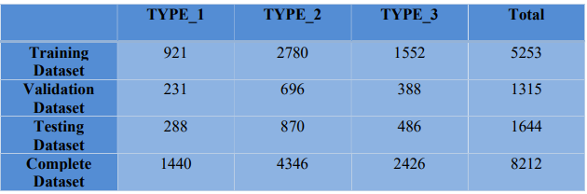
DATASET SPLIT
Dataset Split: Dataset is splinted randomly by stratified sampling.
Training dataset:
Training dataset contain 80% of total images.
This is divide in 80 : 20 in model training and model validation dataset.
Testing dataset:
Testing dataset contains 20% images.

Slide 16
PROPOSED METHOD

Slide 17
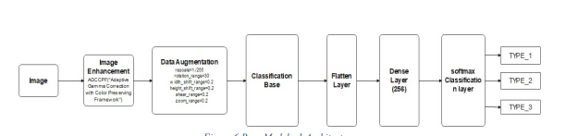
BASE MODEL 1
In Base model 1 we have used transfer learning; the pre-trained weights from the ImageNet for the classification base
and applied flatten layer on feature map extracted from the classification base
and used dense layer and then SoftMax layer for classifying the image

Slide 18
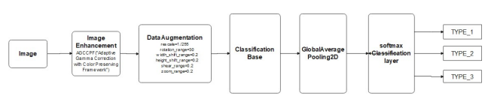
BASE MODEL 2
In this we have used transfer learning; the pretrained weights from the ImageNet for the classification base and
applied GlobalAveragePolling2D on feature map extracted from the classification base and
then SoftMax layer for classifying the image.

Slide 19
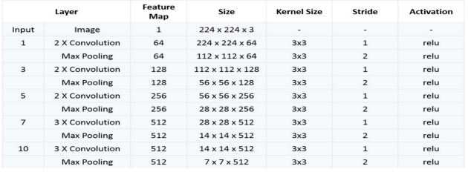
CLASSIFICATION BASE LAYER
VGG16:

Slide 20
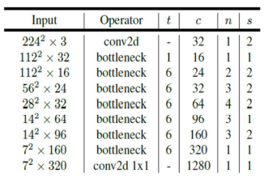
CLASSIFICATION BASE LAYER
MobileNet

Slide 21
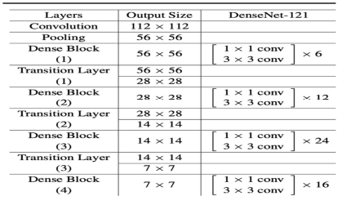
CLASSIFICATION BASE LAYER
DenseNet

Slide 22
PROPOSED MODEL
In proposed model we have used two classification bases VGG16 and DenseNet121 to extract the feature map from the image.
First input layer is passed in both classification base layers parallelly and
then these feature maps are passed separately through global average polling layer that is connected to a dense layer.
Then output of both dense layers are concatenated by concatenation layer
that is passed to a SoftMax layer for classifying the image.

Slide 23
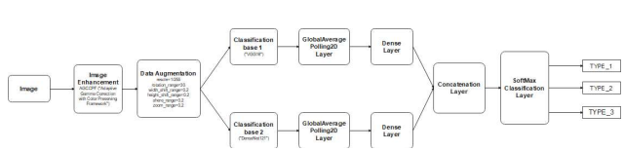
PROPOSED MODEL

Slide 24
TRAINING AND RESULTS

Slide 25
TRAINING
We trained all the models using
RMSPROP optimizer (Gradient based optimizer)
learning rate of 0.00001
No of Epochs = 50 with 260 steps with batch size of 20 image and 60 step of validation with batch size of 20 images.

Slide 26
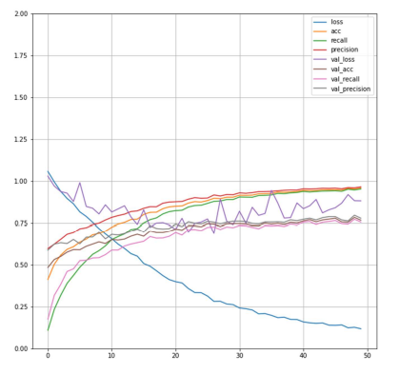
TRAINING
Training graph

Slide 27
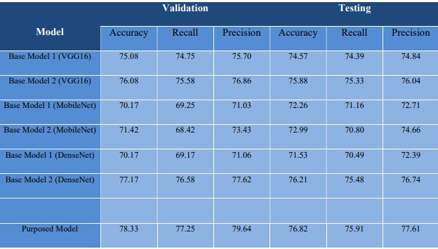
RESULTS

Slide 28
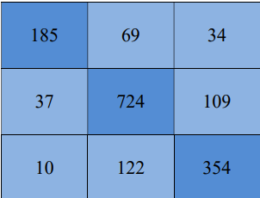
RESULTS
Confusion Matrix

Slide 29
CONCLUSION

Slide 30
Thank You

